Slide 1
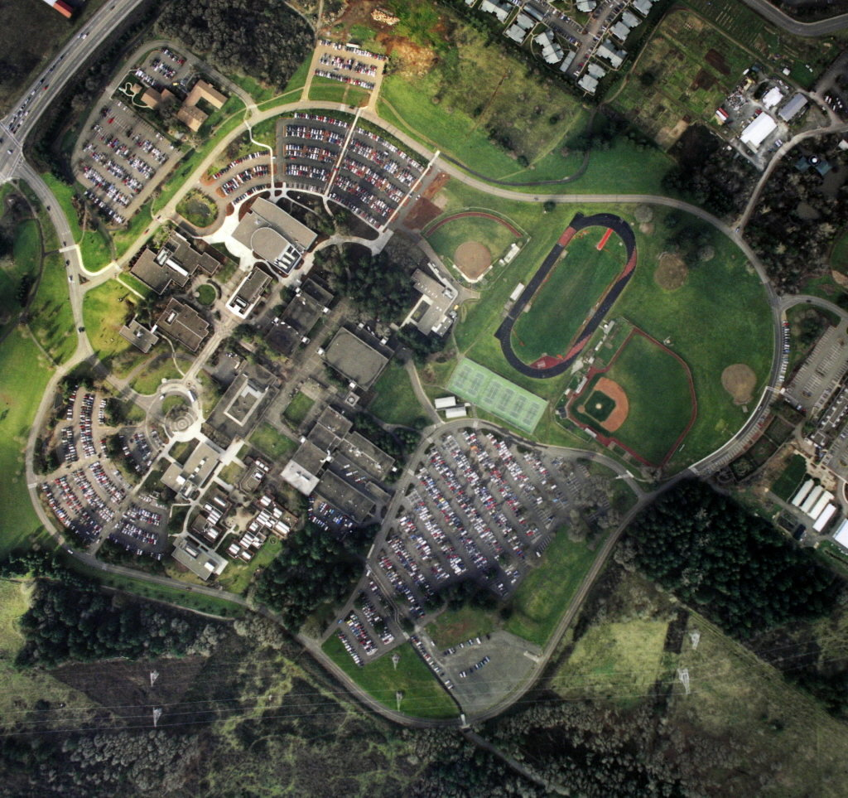
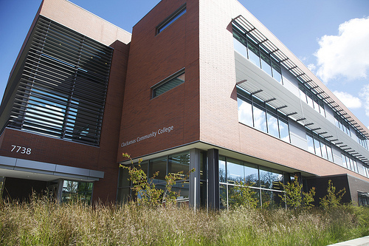
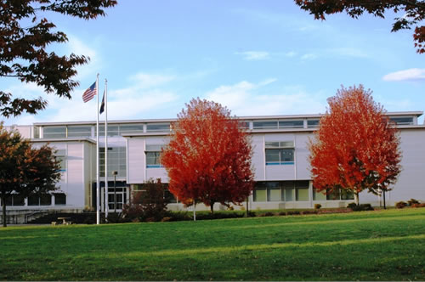
2014 Comprehensive Transportation Study

Slide 4
Impetus
Imagine Clackamas
Transportation 2nd biggest student concern
Strategic Priorities 1, 2, 4
Increase retention & persistence
Increase credential completions, transfers, job placement
Improve community connections

Slide 5
Comprehensive Transportation Plan Overview
Current State Assessment
Regional Comparator Transportation
Recommendations for Improvements

Slide 6
Current State Assessment
Assess existing transportation network
Meet with stakeholders
CCC students
Administrators
Community leaders
Transportation professionals

Slide 7
Parking

Slide 8
Shuttle Ridership

Slide 9
Transportation Survey
For students AND faculty/staff
Opinion on specific transportation situations
Mode choice
Desired transportation improvements
Open-ended feedback
Sending this out SOON!

Slide 11
Questions?

